Slide 1

Rutgers Data Science Bootcamp
The Five Guys
Project 1 - NBA Analysis
June 23, 2020

Slide 2

Contents
1. Project
Overview
2. Data
Assembly
3. League
Analysis
4. Team
Analysis
5.
Conclusion

Slide 3
The Five Guys
Handcrafted Analytics and Py’s since 2020
Resul Cobanoglu
Lead Data Engineer
Patrick Patten
Data Engineer
Analytics Strategist / SME
Matt Dionne
PM
Analytics
Derek Leckner
Analytics
John Thomson
Analytics

Slide 4
1. Project Overview

Slide 5

Hypothesis
“If we look at NBA team performance vs game attendance, we can predict which teams will perform better without an audience in the upcoming ‘Disney Bubble League’ in July 2020.”

Slide 6






Parameters
Seasons* | 2018-2019 | 2019-2020
Total Teams | N=30 | N=30
Total Games | N=1217 | N=985
Average Attendance per Game | 17,870 | 17,797
We evaluated several data sources and found everything available from two APIs on SportRadar.com.
*We analyzed regular season play only to limit additional variables in the playoffs.

Slide 7
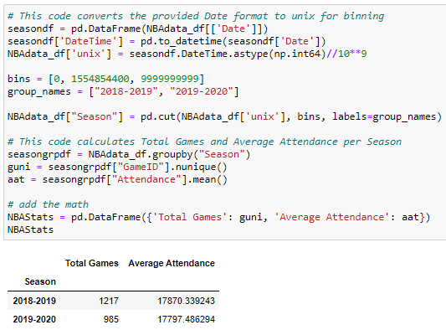
Parameters Code
Code to add Seasons column and calculate the parameters.

Slide 8
Considerations
How does attendance impact key performance indicators?
Home Team vs Away Team
Final Score
1st Quarter Score
FG%
3pt%
FT%

Slide 9
2. Data Assembly

Slide 10

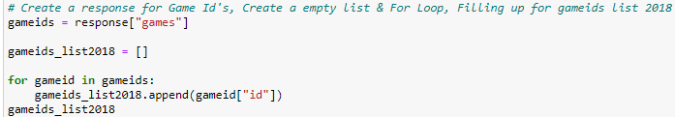
Data Assembly
We set up the first API call to pull in the Game ID. We had to make these calls twice as it only allowed one seasons worth of data per call.

Slide 11
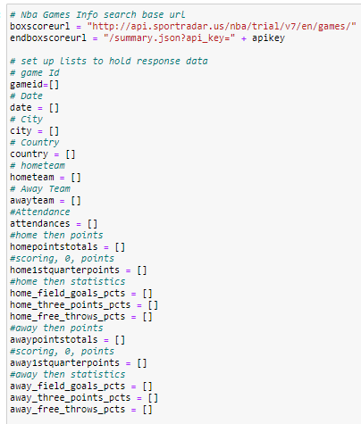
Data Assembly
This sets up the next API call to retrieve the rest of the data based on the Game ID from our previous pull.

Slide 12
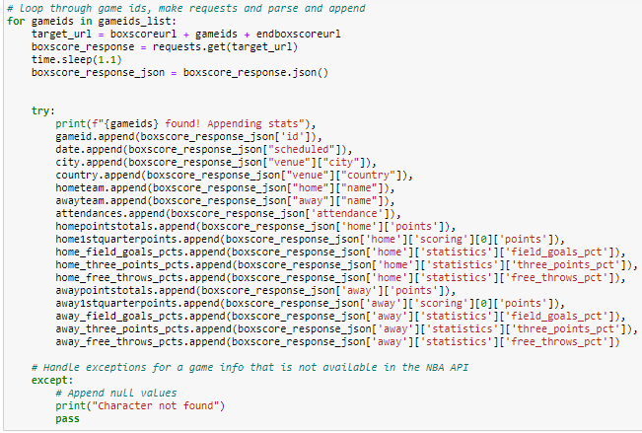
Data Assembly
This code maps the json data to the lists from the previous step:

Slide 13
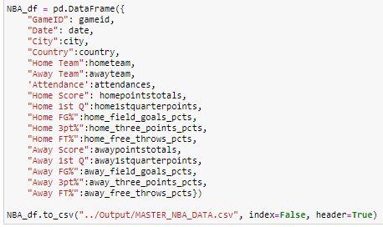
Data Assembly
Lastly, we build our dataframe and export to csv for the analysis team.

Slide 14
3. League Analysis

Slide 15
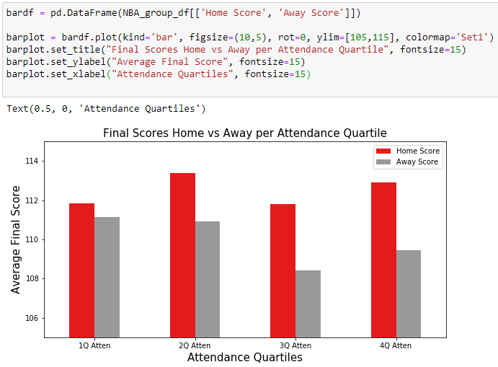
Home vs Away - League Final Score
We have grouped attendance into 4 quartiles for ease of analysis.
As you might expect, as attendance grows the away team doesn’t seem to perform as well.
What is interesting is that the home team seems to be negatively affected by larger audiences as well.

Slide 16
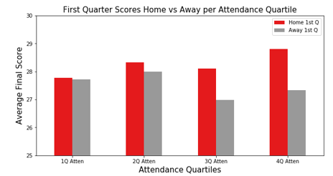
Home vs Away - League Final Score
We see here that at least in the first quarter, attendance seems to benefit home teams.

Slide 17
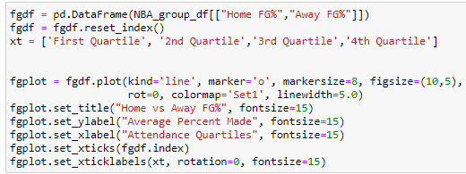
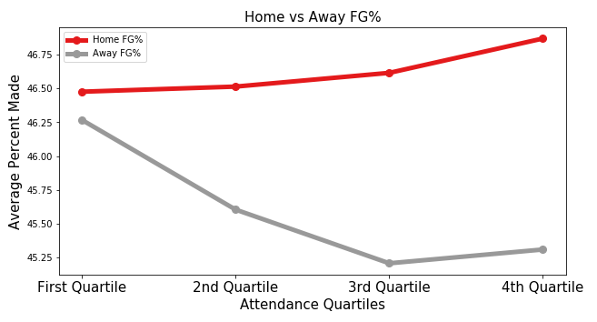
Home vs Away – League Field Goal %
For overall field goal %, attendance seems to drastically affect away teams’ performance, while benefiting home teams.

Slide 18
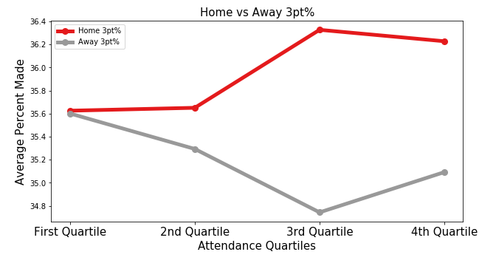
Home vs Away – League 3 Point %
We found that 3-point percentages seem to improve for away teams when the venue is the most full (Q4).
This is likely due to the noise of the crowd impacting the home team’s ability to communicate on defense.

Slide 19
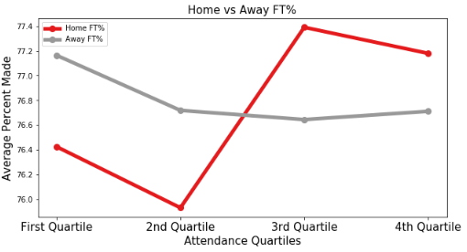
Home vs Away – League Free Throw %
Free throws take the defense out of the equation.
The home team seems to be inspired to make a greater percentage when the venue is fuller, but at a certain point it becomes a distraction.
Meanwhile, the away team only seems to be affected by the crowd up to a certain degree.

Slide 20
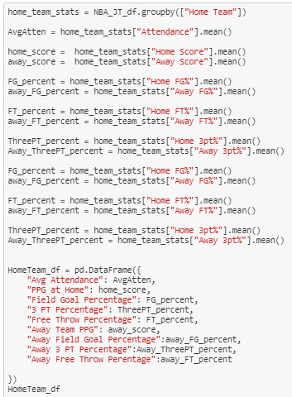
Home vs Away Teams – Data Formating
This code takes all the home games and groups them by team to sort them by lowest to highest average attendance.

Slide 21
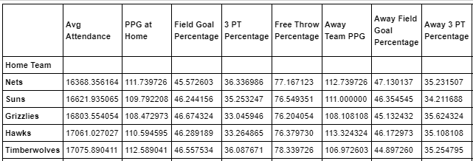
Home vs Away Teams – DataFrame
The resulting dataframe is what we used to derived the following plots.

Slide 22
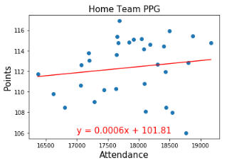
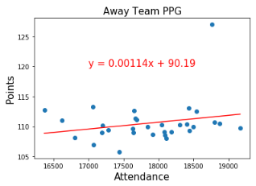
Home vs Away Teams – Points Per Game
According to famous NBA statistician Jeff Sagarin, the average home court advantage in the NBA is right around 2.33 points per game.
We agree with Jeff per our findings.

Slide 23
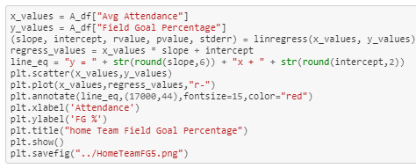
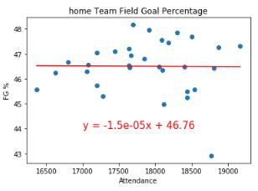
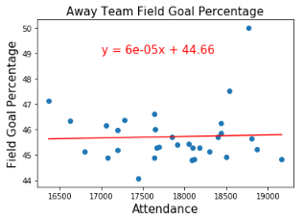
Home vs Away Teams – Field Goal Percentage

Slide 24
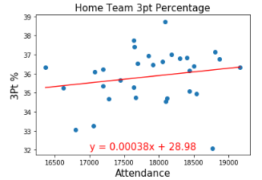
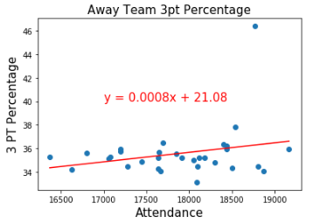
Home vs Away Teams – 3 Point Percentage
The home team advantage is on display when we look at 3pt percentages per team.

Slide 25
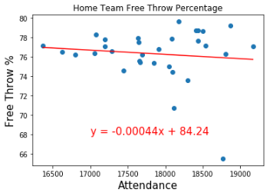
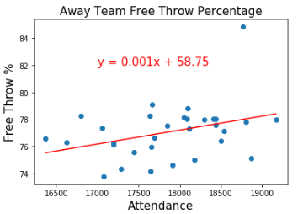
Home vs Away Teams – Free Throw Percentage
When looking at free throw percentages we see a flat line as with the previous examples.

Slide 26
4. Team Analysis

Slide 27
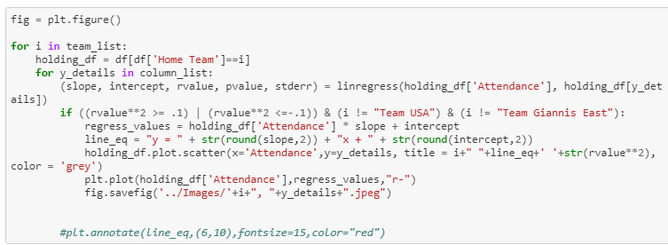
Team Analysis - Code
The following code plots individual team performance across all of their games in a few categories.

Slide 28
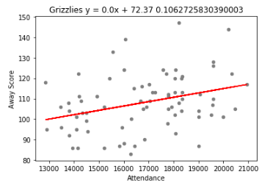
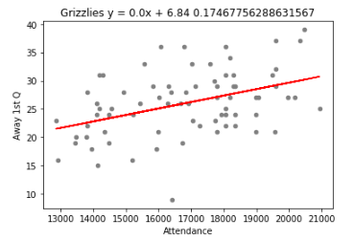
Team Analysis - Grizzlies
While the previous graphs show there may be some correlation, the r² value from individual teams suggests otherwise.

Slide 29
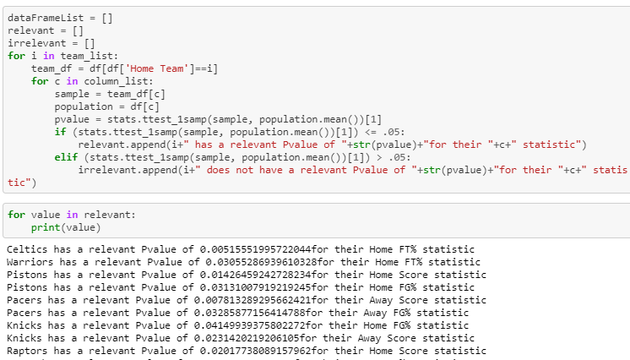
Team Analysis – p-Value

Slide 30
5. Conclusion

Slide 31
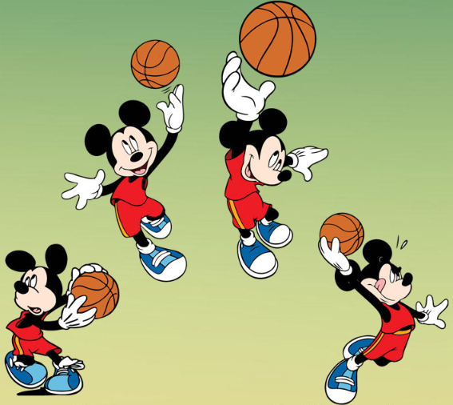
Conclusion
While we found some interesting correlations between attendance and performance, we could not confirm causation.
We’ll be watching along with everyone else!

